Slide 1
DIGITAL PORTFOLIO

Slide 2
PROJECT TITLE
STUDENT NAME :JAYASRI.Y
REGISTER NUMBER AND NM ID:2422K1572 Asbru4q2422k1572
DEPARTMENT: COMPUTER SCIENCE
COLLEGE :KSG COLLEGE OF ARTS AND SCIENCE
UNIVERSITY:BHARATHIYAR UNIVERCITY

Slide 3
PROJECT STATEMENT
1. Objective: What do you aim to achieve? 2. Scope: What specific aspects will you cover? 3. Goals: What are the desired outcomes? 4. Target audience: Who will benefit from the project

Slide 4
PROJECT OVERVIEW
Project Objectives - To establish a pineapple processing plant that produces high-quality pineapple products, such as juice, pulp, and canned pineapple - To cater to the growing demand for healthy and natural food products - To create a sustainable and efficient production process that minimizes waste and environmental impact

Slide 5
WHO ARE THE END USER
1. Demographics: End-users can vary widely in terms of age, location, occupation, and other demographic factors. 2. Needs and Preferences: Understanding the specific needs, preferences, and pain points of end-users is crucial for designing and delivering effective products or services. 3. User Experience: End-users’ experiences and interactions with a product or service can significantly impact their satisfaction, loyalty, and overall perception of the brand. 4. Targeting and Engagement: Identifying and understanding end-users enables businesses to tailor their marketing efforts, product development, and customer support to meet the specific needs of their target audience.

Slide 6
TOOLS AND TECHNOLOGIES
1. Software Tools: Utilize software applications like project management tools (e.g., Trello, Asana), design tools (e.g., Figma, Adobe XD), and productivity tools (e.g., Microsoft Office, Google Workspace). 2. Development Technologies: Leverage programming languages (e.g., Python, JavaScript), frameworks (e.g., React, Angular), and databases (e.g., MySQL, MongoDB) to build and deploy applications. 3. Collaboration Platforms: Employ collaboration tools like Slack, Microsoft Teams, or GitHub to facilitate communication, version control, and teamwork. 4. Emerging Technologies:Explore innovative technologies like artificial intelligence (AI), blockchain, or Internet of Things (IoT) to drive business growth, improve efficiency, and enhance customer experiences.

Slide 7
PORTFOLIO DESIGN AND LAYOUTS
1. Visual Hierarchy: A layered portfolio design creates a visual hierarchy, guiding the viewer’s attention to the most important elements. 2. Organization: Layering helps organize content, making it easier for visitors to navigate and find specific projects or information. 3. Depth and Dimension:Layering adds depth and dimension to a portfolio, making it more engaging and interactive. 4. Storytelling: A layered portfolio can tell a story about the creator’s work, showcasing their skills, experience, and accomplishments in a visually appealing way.

Slide 8
FEATURES AND FUNCTIONALITY
1. Purpose-Driven:Functional design prioritizes purpose and usability, ensuring that every element serves a specific function. 2. User-Centered: It focuses on meeting the needs and expectations of the user, creating an intuitive and efficient experience. 3. Simplified Complexity: Functional design simplifies complex systems or products, making them easier to understand and use. 4. Effective Problem-Solving: It provides effective solutions to problems, balancing aesthetics with practicality and usability

Slide 9
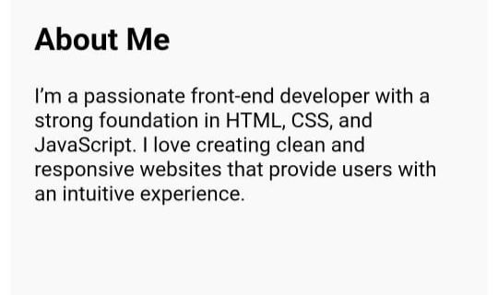
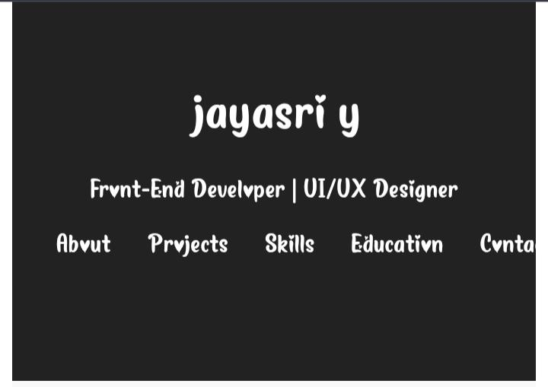
RESULT AND SCREENSHOTS

Slide 10
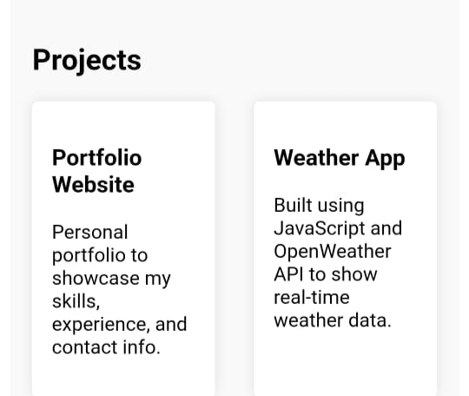
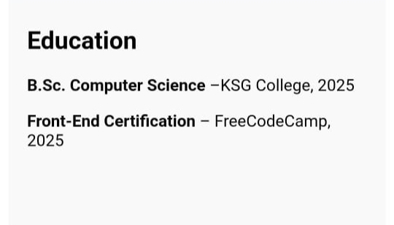
SCREENSHOT

Slide 11
CONCLUSION
1. Problem statements 2. Pineapple project overview 3. End-users 4. Tools and technologies 5. Portfolio design

